Slide 1

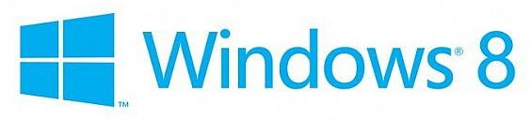

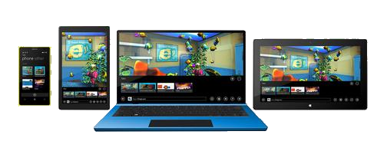
Windows Universal Layout Controls

Slide 2
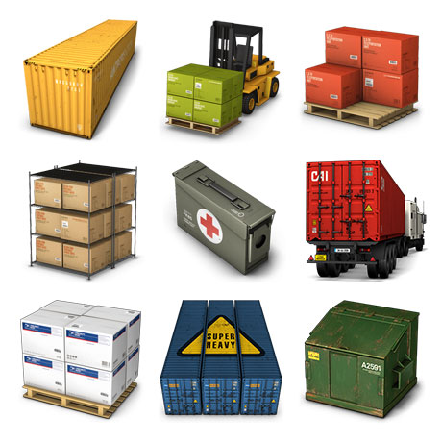
Table of Contents
What is Container?
Containers in XAML
StackPanel
Canvas
Grid

Slide 3
What is a Container?
Containers are things that contain other things
Like divs and sections in HTML
They hold other controls / elements
Used to build the layout of the application
Every container is given a space to consume
All his children are in this space

Slide 4
Containers in XAML
In XAML containers are called Panels
Three common types of panels
Panels with absolute coordinates
Panels with stacking order
Panels with proportional or with rows/columns
Absolute coordinates Panels
Canvas
Controls inside the canvas are arranged based on the Canvas position and size

Slide 5
Containers in XAML (2)
Stacking Panels
StackPanel
Elements are arranged in a stacking order
i.e. first come goes in the beginning
Proportional Panels
Grid, VariableSizedWrapGrid and WrapGrid
Arrange the elements in a table-like layout

Slide 6
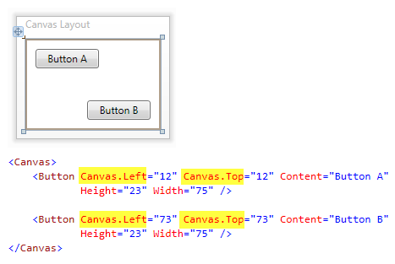
The Canvas Container

Slide 7
The Canvas Container
The Canvas is a layout container
An element that holds other elements
Elements inside are positioned using fixed coordinates
Places elements behind or in front of others (depending on the z-order)
Supports size and clipping

Slide 8
The Canvas Container (2)
To position elements inside a Canvas use attached properties
Example:
Places a Rectangle at specific location in a Canvas
<Canvas>
<Rectangle Canvas.Left="30" Canvas.Top="30"
Fill="Red" Width="100" Height="100"/>
…
</Canvas>

Slide 9
The Canvas Container (3)
Placing elements behind or in front of others depends on the z-order
The default z-order
Defines which elements are "on top of" the other elements
Determined by the order in which the children are added to the Canvas
Customize the z-order of any child element using Canvas.ZIndex attached property

Slide 10
The Canvas Container – Example
<Canvas Background="White" Height="680">
<Rectangle Canvas.Left="0" Canvas.Top="0" Fill="Red"
Width="100" Height="100" Canvas.ZIndex="3" />
<Rectangle Canvas.Left="20" Canvas.Top="20"
Fill="Orange" Width="100" Height="100"
Canvas.ZIndex="2" />
<Canvas Canvas.Left="300" Canvas.Top="300"
Canvas.ZIndex="1">
<Rectangle Width="120" Height="330" RadiusX="20"
RadiusY="20" Fill="Black"/>
<Ellipse Canvas.Left="10" Canvas.Top="10"
Width="100" Height="100" Fill="Red"/>
</Canvas>
</Canvas>

Slide 11
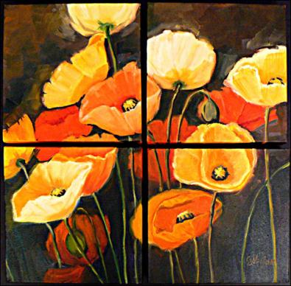
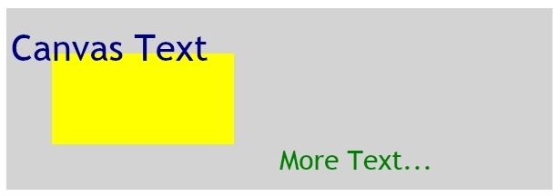
Customize the Z-order and Multiple Canvas Elements
Live Demo

Slide 12
StackPanel

Slide 13
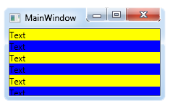
StackPanel
The StackPanel arranges the elements in one row/column
Depends on the orientation property
If the size of each element is not explicitly set all elements have the same width/height
Can set flow orientation
Vertical or Horizontal
<StackPanel>
<TextBlock Text="Text" Background="Yellow"/>
<TextBlock Text="Text" Background="Blue"/>
</StackPanel>

Slide 14
StackPanel
Live Demo

Slide 15
Grid Panels
Grid and UniformGrid

Slide 16
Grid
The most powerful layout container in XAML
Everything can be done with Grid
Sometimes way harder than using StackPanel
Arranges the elements in a table-like layout
Predefined number of rows and columns
Each element has explicitly set grid row/column
Using the attached properties Grid.Row and Grid.Column
If no columns/rows are defined, works the like canvas

Slide 17
Grid (2)
Number of Rows is defined by a content property called "RowDefinitions"
Each row can be set a height
The same with "ColumnDefinitions"
<Grid.RowDefinitions>
<RowDefinition Height="50"/>
<RowDefinition/>
<RowDefinition/>
</Grid.RowDefinitions>
<Grid.ColumnDefinitions>
<ColumnDefinition/>
<ColumnDefinition Width="50"/>
</Grid.ColumnDefinitions>

Slide 18
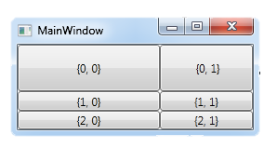
Grid (3)
Each of the elements in a Grid should have a Grid.Row and/or Grid.Column property set
<Grid>
…
<Button Grid.Row="0" Grid.Column="0" Content="{0, 0}"/>
<Button Grid.Row="0" Grid.Column="1" Content="{0, 1}"/>
<Button Grid.Row="1" Grid.Column="0" Content="{1, 0}"/>
<Button Grid.Row="1" Grid.Column="1" Content="{1, 1}"/>
<Button Grid.Row="2" Grid.Column="0" Content="{2, 0}"/>
<Button Grid.Row="2" Grid.Column="1" Content="{2, 1}"/>
</Grid>

Slide 19
Grid
Live Demo

Slide 20
Viewbox

Slide 21
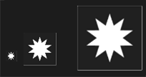
Viewbox
Viewbox is a container control that scales its content to a specified size
Stretches to
Has single child element
Can manipulate Stretch and StretchDirection
<StackPanel Margin="5" Orientation="Horizontal">
<Viewbox MaxWidth="100" MaxHeight="100" Name="vb1">
<Image Source="flower.jpg"/>
</Viewbox>
<Viewbox MaxWidth="200" MaxHeight="200" Name="vb2">
<Image Source="flower.jpg"/>
</Viewbox>
</StackPanel>

Slide 22
Border Container

Slide 23
Border Container
The Border is a special kind of container
It can hold only one child element
The child element becomes surrounded by a border
The Border properties for border style
BorderBrush
BorderThickness
CornerRadius

Slide 24
XAML Overview
http://academy.telerik.com

